Slide 1
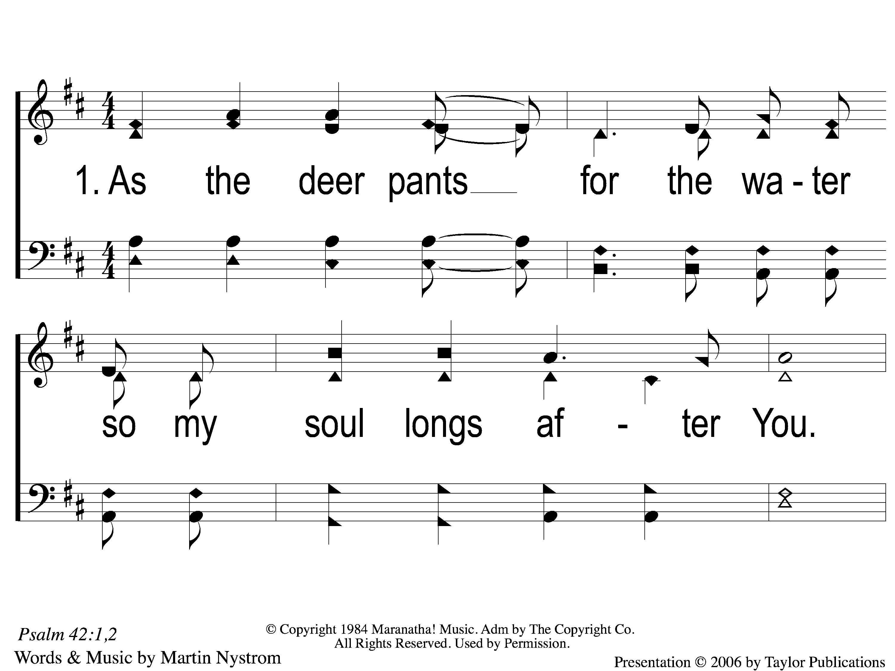
1-1 As the Deer
As The Deer
71

Slide 2
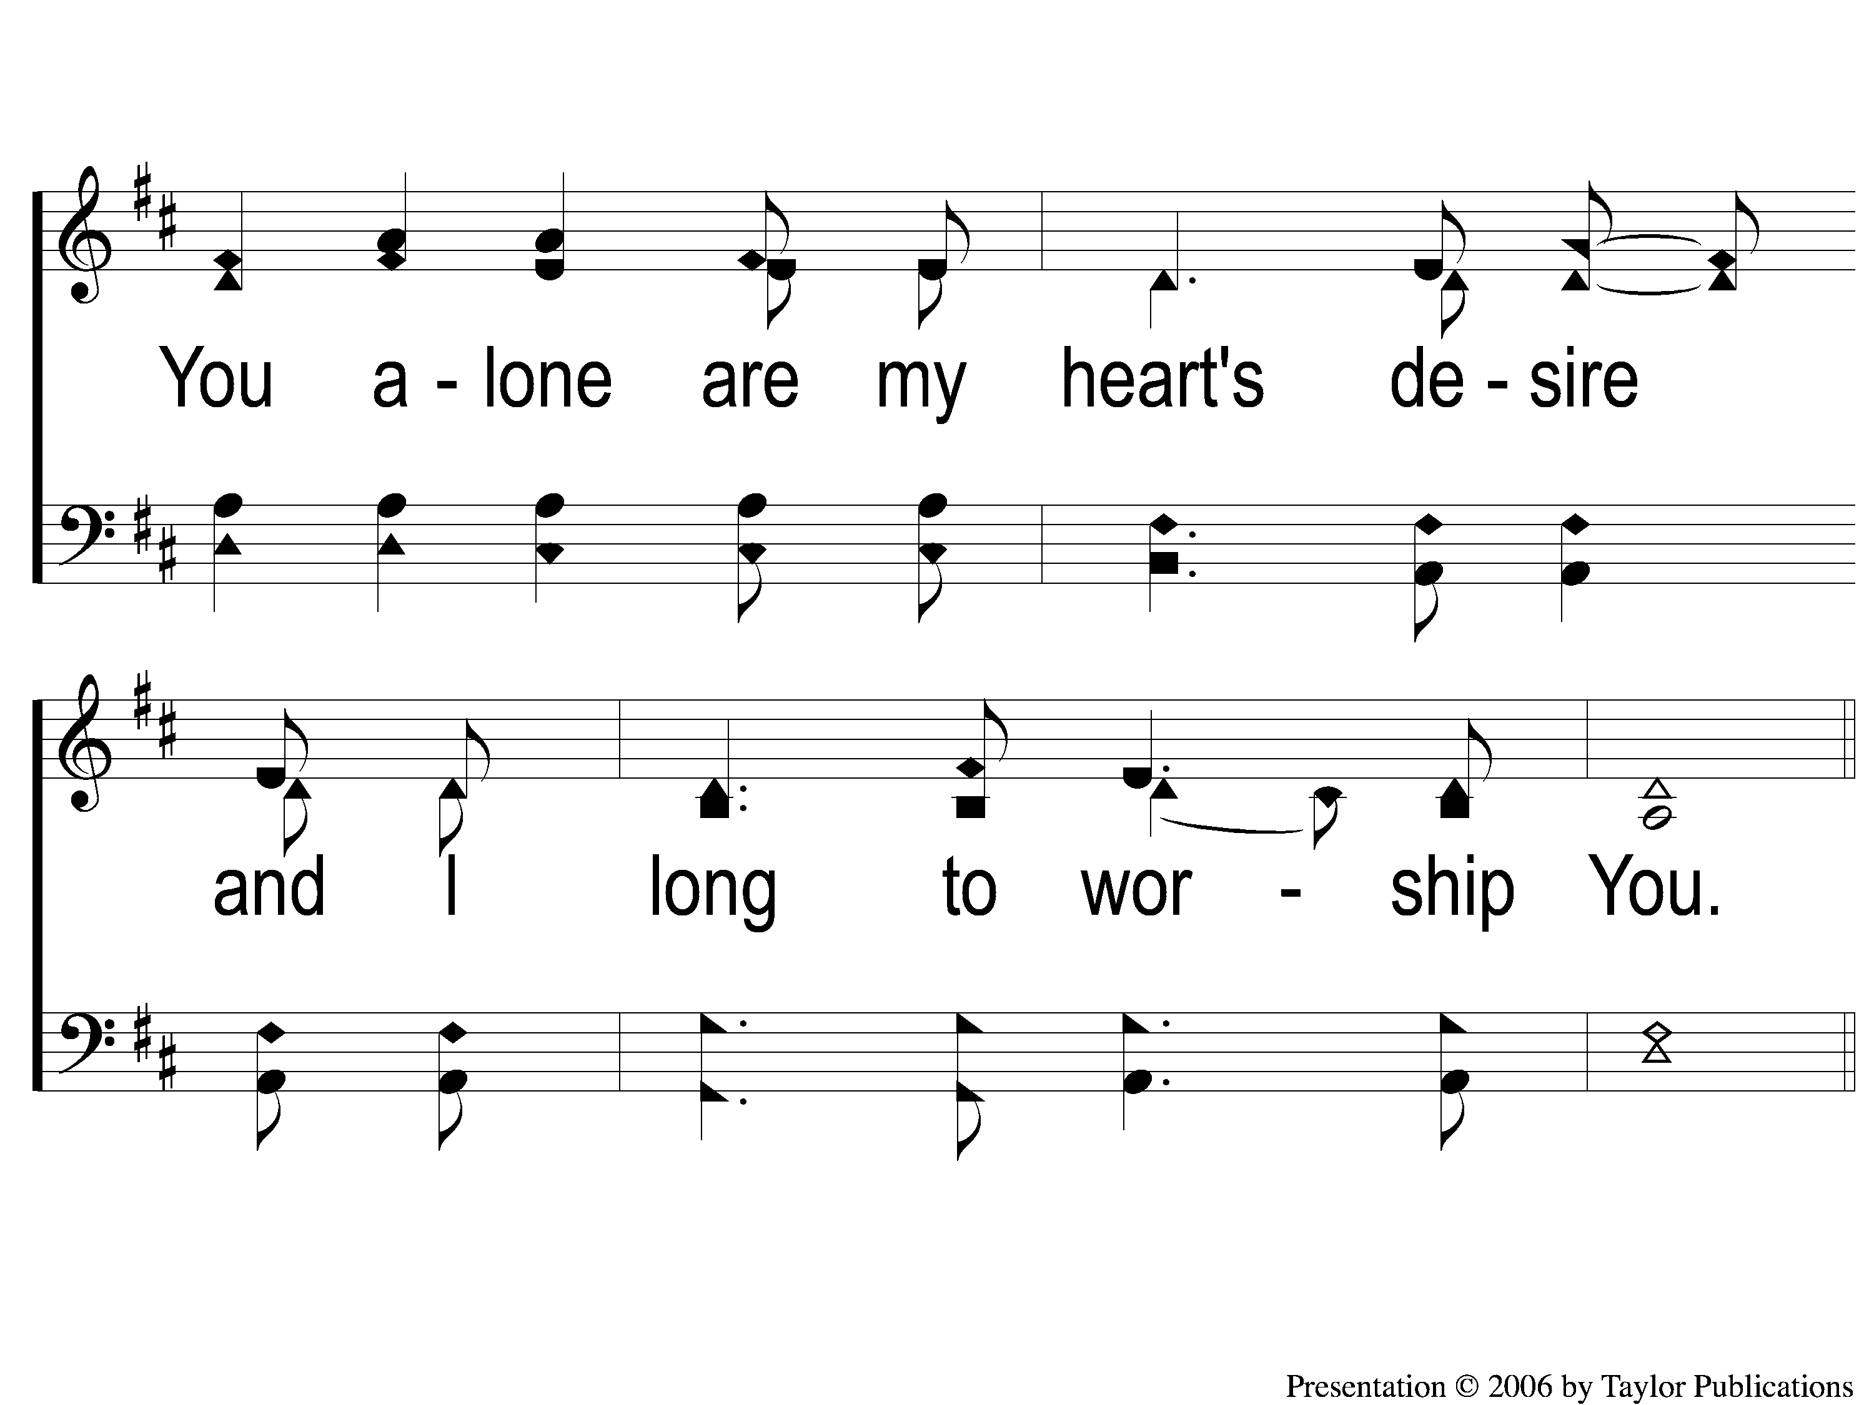
1-2 As the Deer
As The Deer
71

Slide 3
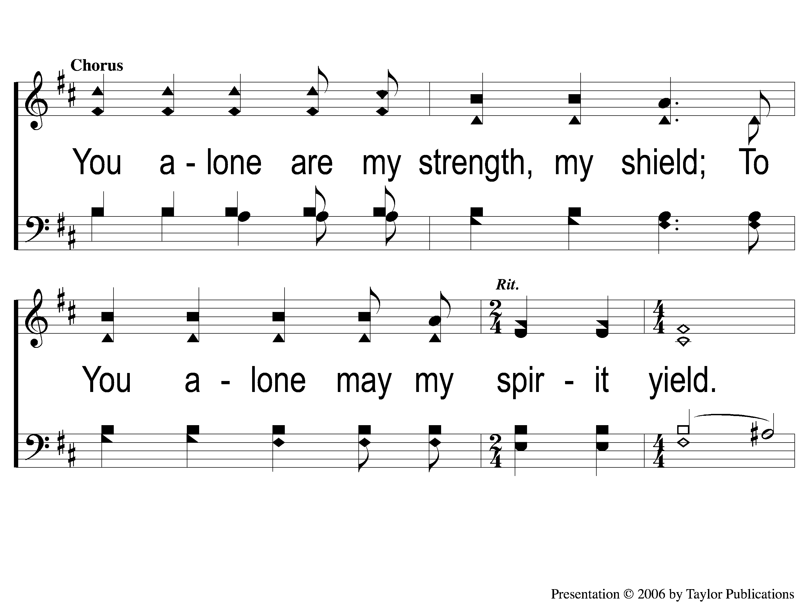
C-1 As the Deer
As The Deer
71

Slide 4
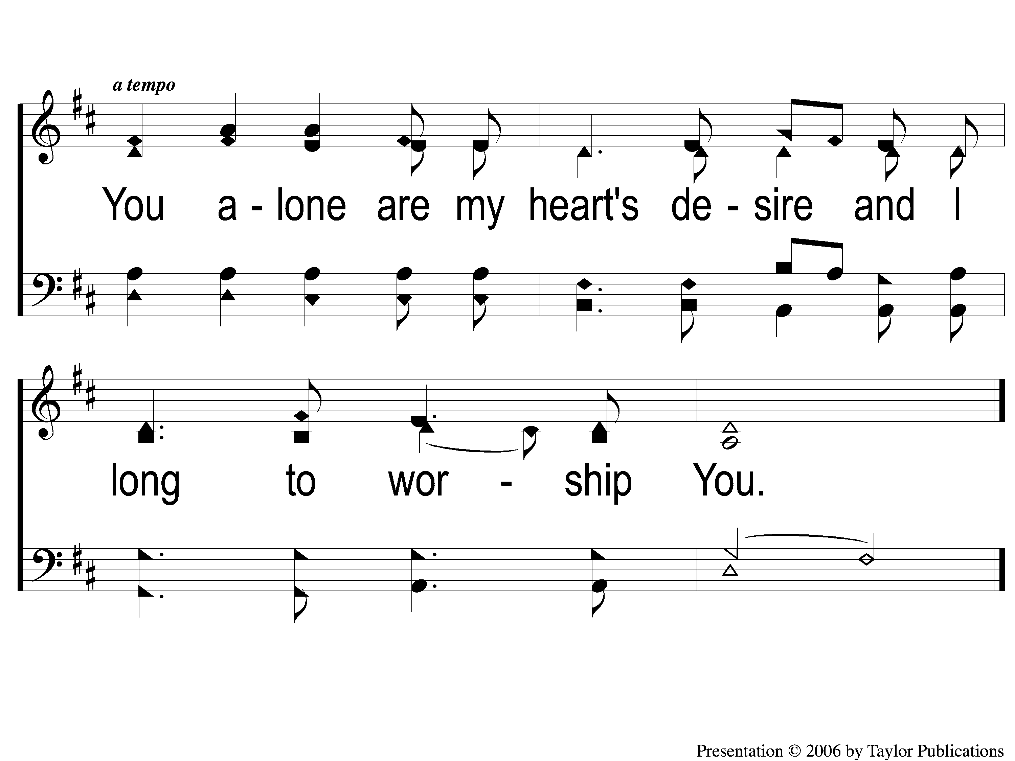
C-2 As the Deer
As The Deer
71

Slide 5
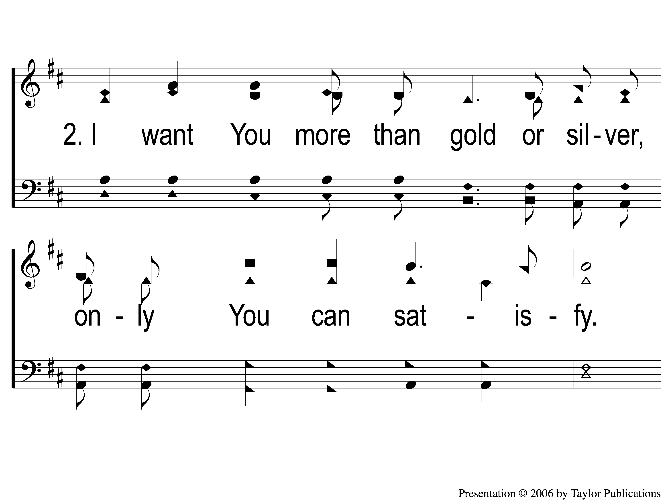
2-1 As the Deer
As The Deer
71

Slide 6
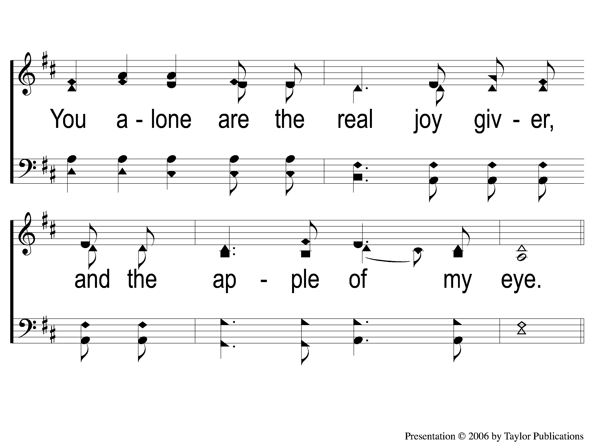
2-2 As the Deer
As The Deer
71

Slide 7
C-1 As the Deer
As The Deer
71

Slide 8
C-2 As the Deer
As The Deer
71

